Slide 1

Generative Model-Based Testing on Decision-Making Policies
Lei HAN
Lei HAN(lhanao@connect.ust.hk)
The Hong Kong University of Science and Technology
3 May 2024
1
Notes:
I’m on the first year of my PhD study and specific in computer version

Slide 2
Table content
Decision-Making Policy
Challenges in Testing Decision-Making Policies
Motivation on Testing Decision-Making Policies
Proposed Method: diffusion model + novelty-based guidance
Experiment: Research Questions
Q & A
Lei HAN(lhanao@connect.ust.hk)
The Hong Kong University of Science and Technology
3 May 2024
2

Slide 3
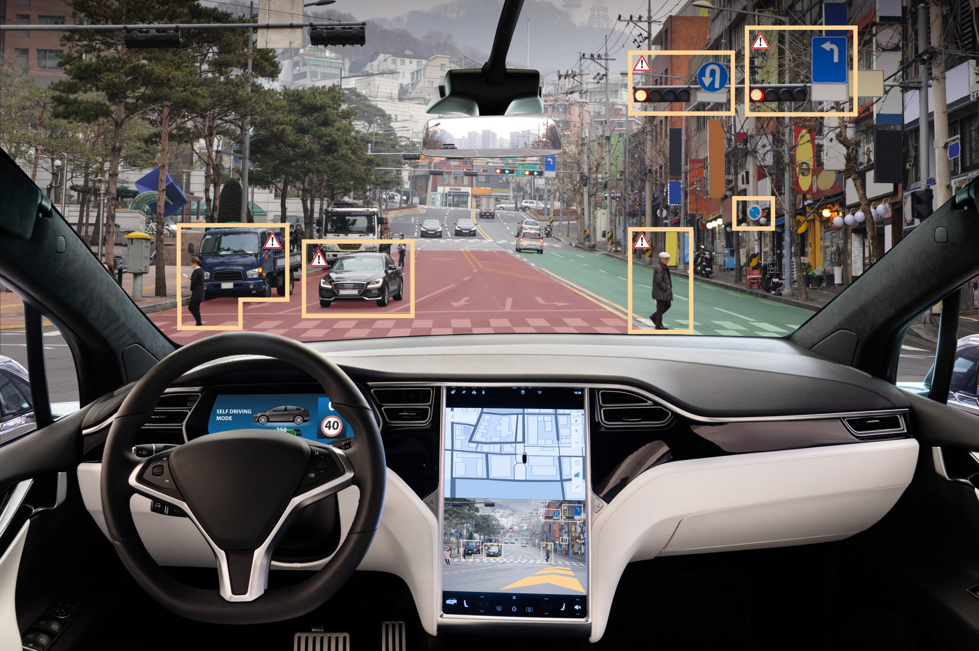


Decision-making devices
Lei HAN(lhanao@connect.ust.hk)
The Hong Kong University of Science and Technology
3 May 2024
3
Notes:
Sweeping robot
剪草机器人 lawn mowing robot
Manufacturing Robots

Slide 4
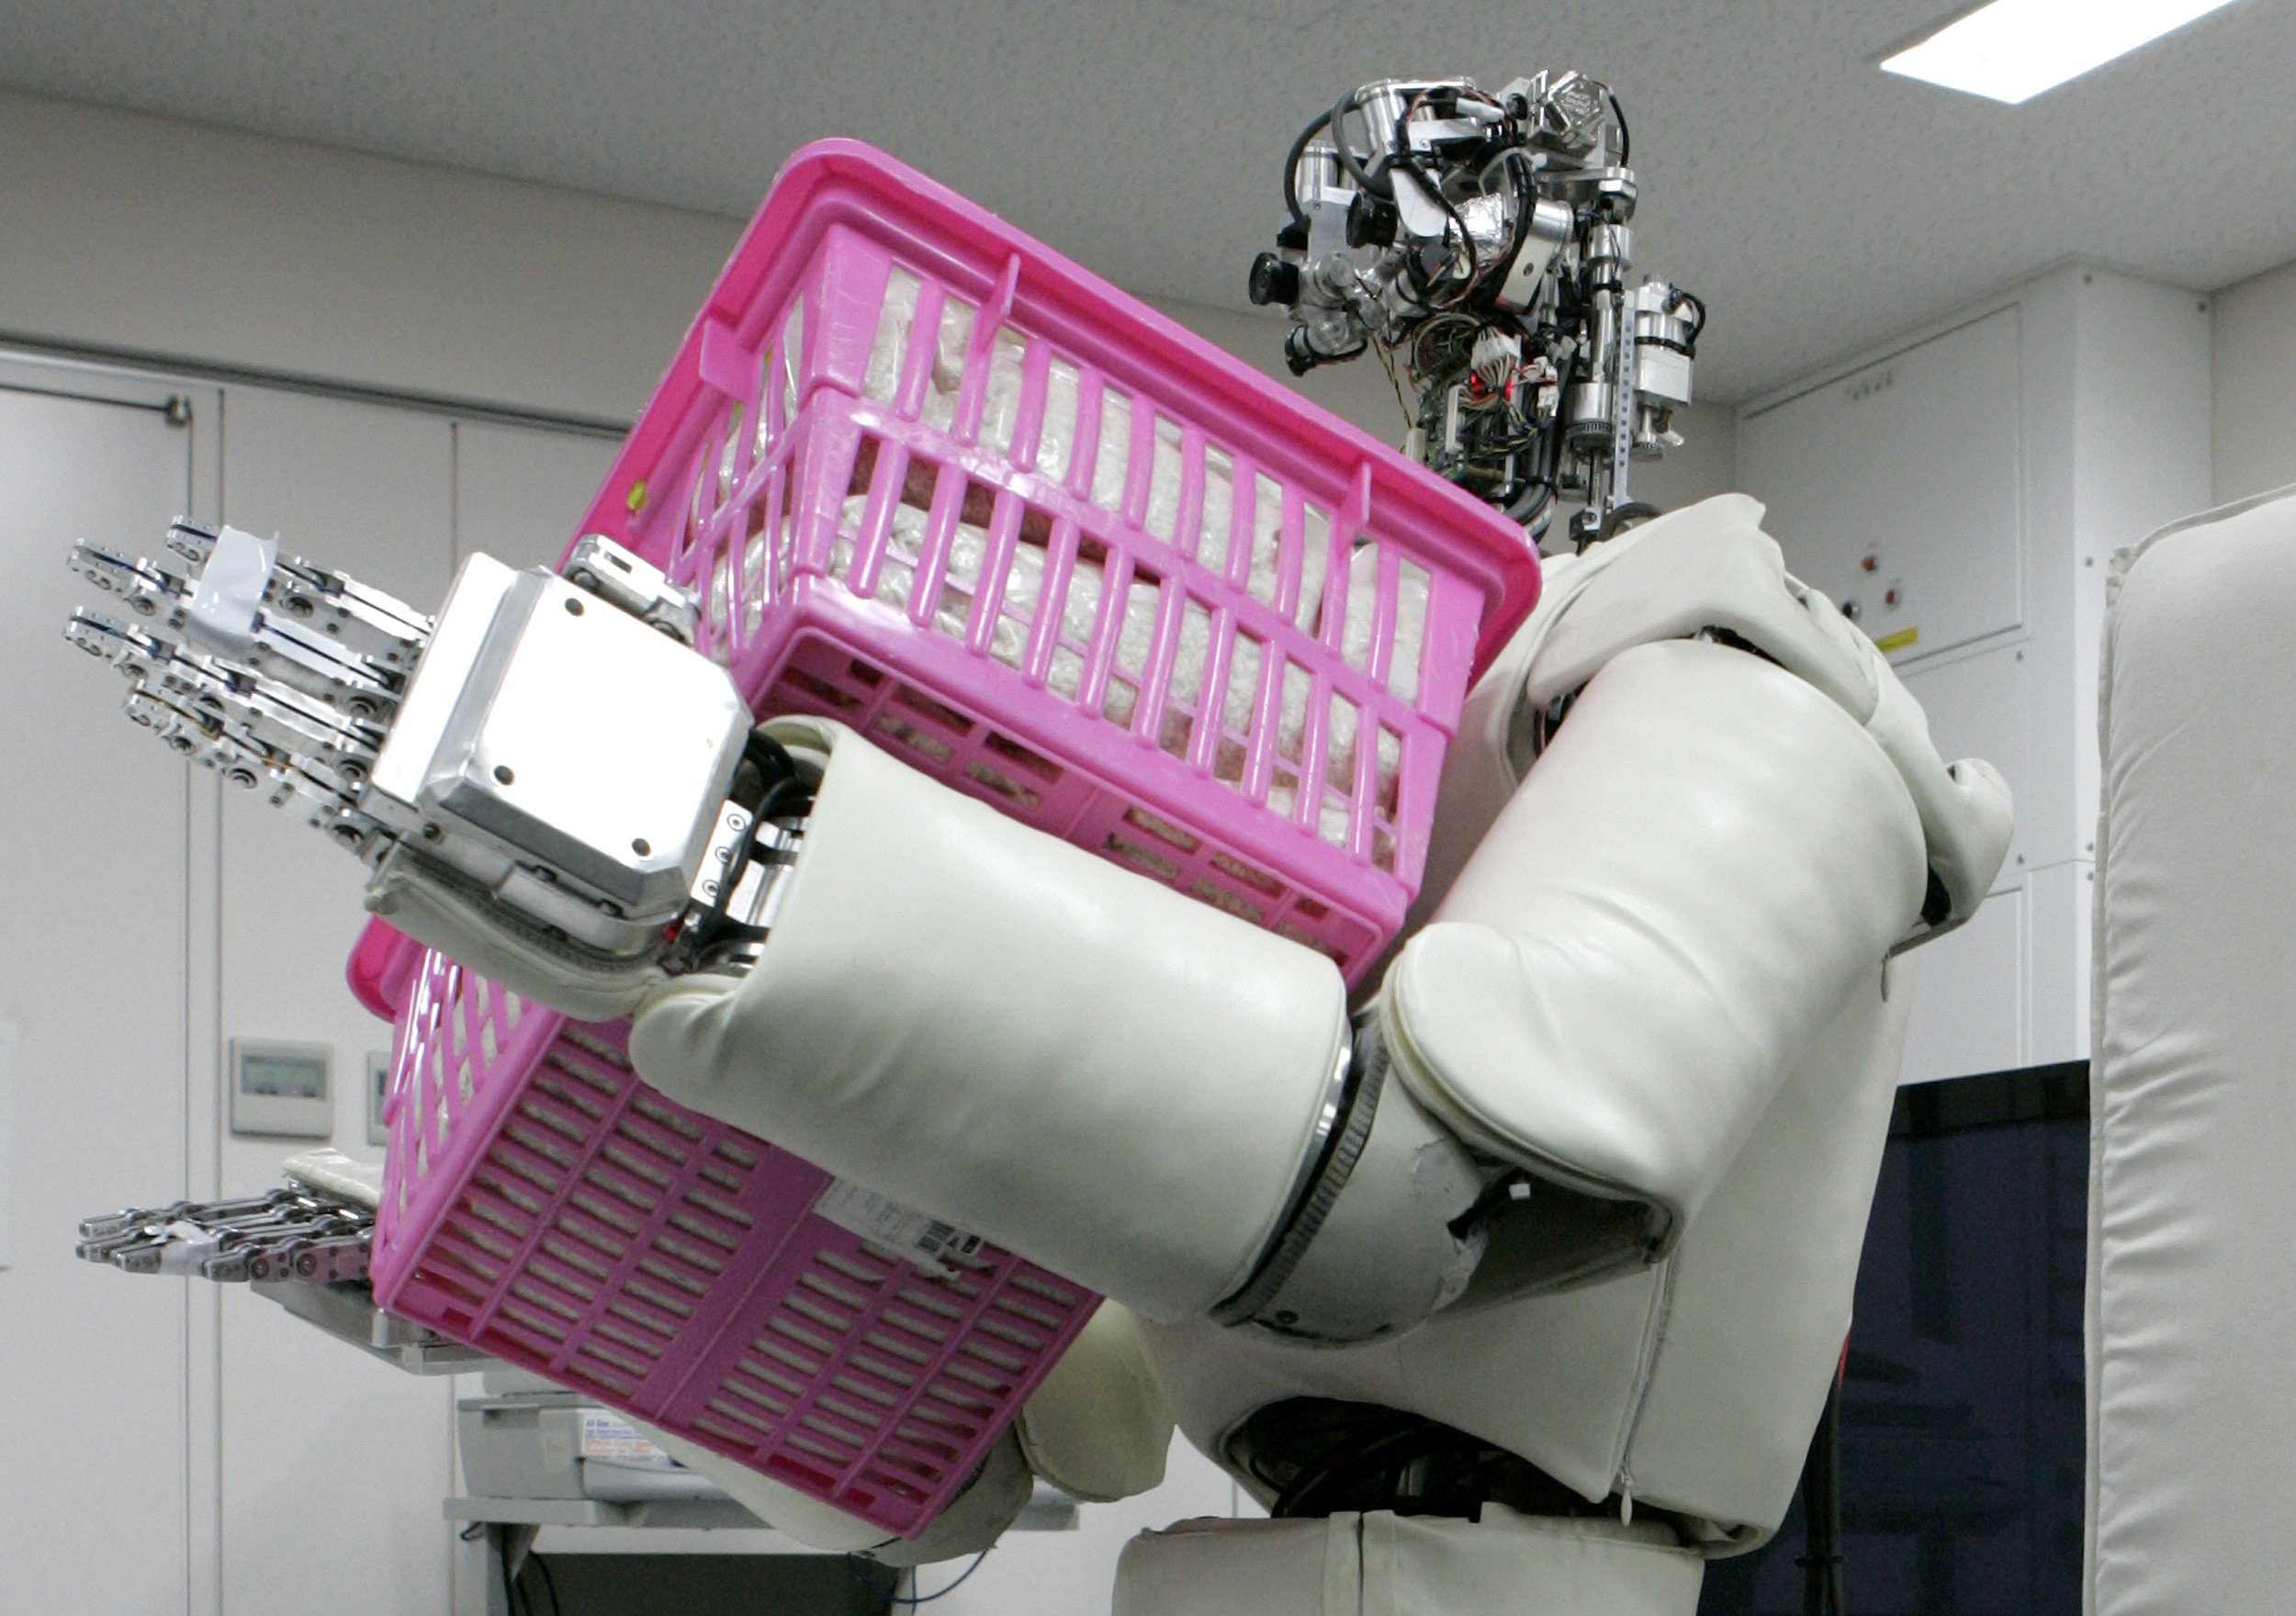
https://doi.org/10.1371/journal.pone.0281282
Nearly 40% of the time spent on housework could be automated within a decade
Task | 5-year prediction (std.) | 10-year prediction (std.)
Grocery shopping | 45.25 (24.69) | 59.34 (23.40)
Shopping (other than groceries) | 39.17 (21.28) | 50.23 (22.71)
Using services | 36.86 (16.96) | 51.63 (20.42)
Household cleaning | 33.55 (19.81) | 46.18 (23.28)
Dish washing | 33.29 (24.91) | 46.89 (26.32)
Cooking | 32.48 (20.22) | 46.05 (23.06)
Ironing and folding | 30.68 (23.67) | 43.52 (25.72)
Laundry | 28.65 (21.89) | 42.95 (23.82)
Teaching a child | 27.40 (18.27) | 39.63 (22.19)
Gardening | 27.17 (20.20) | 39.63 (21.72)
Household and car maintenance | 24.89 (19.48) | 36.11 (21.55)
Caring for an adult | 23.77 (14.57) | 34.77 (17.56)
Making and mending clothes | 21.52 (23.87) | 29.06 (24.89)
Pet care | 21.09 (15.64) | 31.68 (18.63)
Interacting with a child | 14.72 (13.90) | 22.25 (17.67)
Escorting a child outside the home | 14.09 (11.66) | 23.55 (15.13)
Physical childcare | 12.32 (8.42) | 20.77 (12.90)
Mean | 27.47 (21.12) | 39.07 (23.89)
University of Oxford - Oxford Internet Institute 2023
Lei HAN(lhanao@connect.ust.hk)
The Hong Kong University of Science and Technology
3 May 2024
4
Notes:
University of Oxford - Oxford Internet Institute
Lehdonvirta, Vili and Shi, Lulu and Hertog, Ekaterina and Nagase, Nobuko and Ohta, Yuji, The Future(s) of Unpaid Work: How Susceptible Do Experts From Different Backgrounds Think the Domestic Sphere Is to Automation (January 5, 2023). Available at SSRN: https://ssrn.com/abstract=4017695 or http://dx.doi.org/10.2139/ssrn.4017695

Slide 5
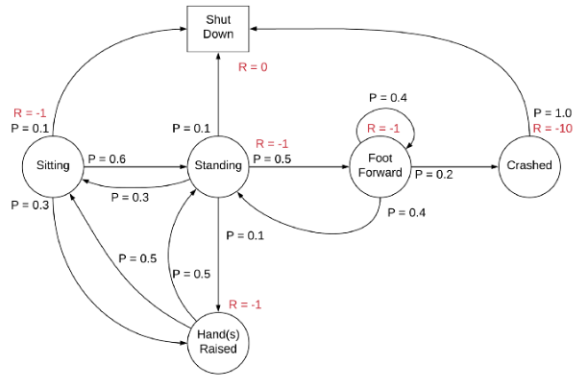
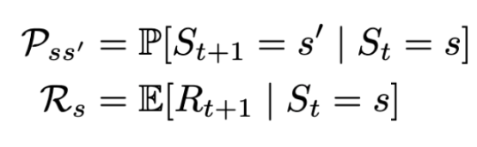
Markov decision process (MDP)
(State, Action, Probability, Reward, γ=Discount factor)
Current state | Next state | Probability | Reward
Standing | Shut down | 0.1 | 0
 | Foot Forward | 0.5 | -1
 | Hand Raised | 0.1 | -1
 | Sitting | 0.3 | 0
A sample Markov chain for the robot example
Lei HAN(lhanao@connect.ust.hk)
The Hong Kong University of Science and Technology
3 May 2024
5
Notes:
What is Markov Decision Process?
An agent’s action is a decision of the current state and the reward function.
Policy: A policy is the thought process behind picking an action. In practice, it’s a probability distribution assigned to the set of actions. Highly rewarding actions will have a high probability and vice versa. If an action has a low probability, it doesn’t mean it won’t be picked at all. It’s just less likely to be picked.

Slide 6
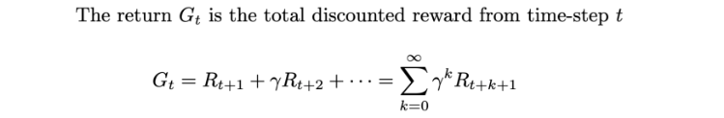
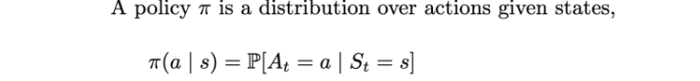
Decision-Making Policy
A policy is the thought process behind picking an action.
In practice, it’s a probability distribution assigned to the set of actions. Highly rewarding actions will have a high probability and vice versa.
If an action has a low probability, it doesn’t mean it won’t be picked at all. It’s just less likely to be picked.
Lei HAN(lhanao@connect.ust.hk)
The Hong Kong University of Science and Technology
3 May 2024
6
Notes:
What is Markov Decision Process?
An agent’s action is a decision of the current state and the reward function.
Policy: A policy is the thought process behind picking an action. In practice, it’s a probability distribution assigned to the set of actions. Highly rewarding actions will have a high probability and vice versa. If an action has a low probability, it doesn’t mean it won’t be picked at all. It’s just less likely to be picked.
An agent under the state S will

Slide 7
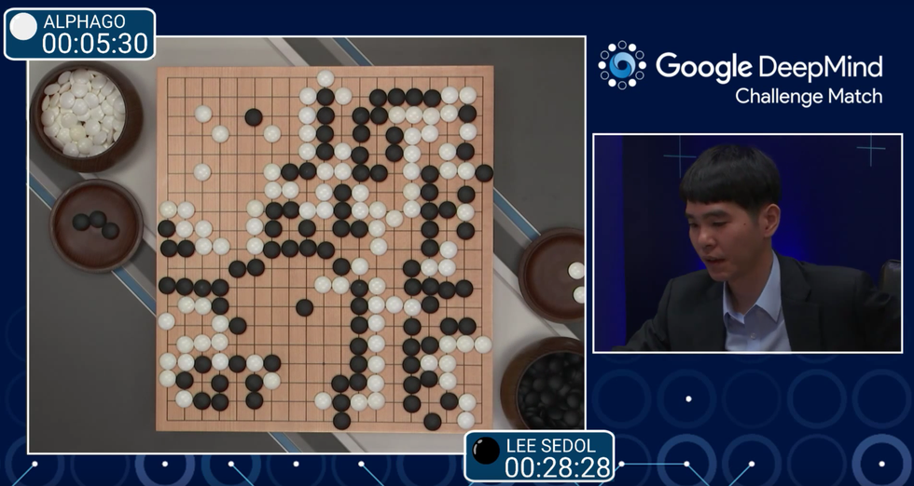
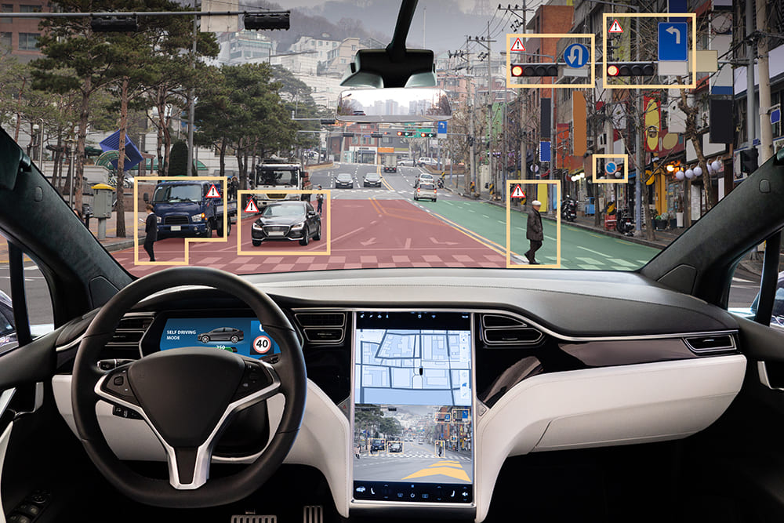

Importance of Testing Decision-Making Policies
DNN-based decision-making policies require more effective test
Methods for solving decision-making problems have garnered much attention in various fields related to artificial intelligence (AI)
An urgent and critical need to develop software engineering techniques to ensure the reliability of decision-making policies.
The objective is to test decision-making policies by exploring scenarios that lead to execution failures.
Lei HAN(lhanao@connect.ust.hk)
The Hong Kong University of Science and Technology
3 May 2024
7

Slide 8
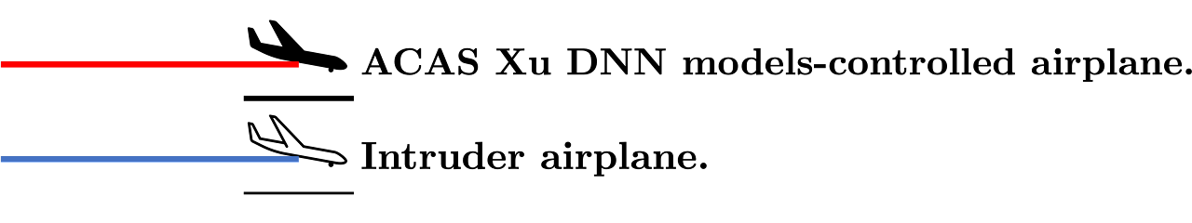
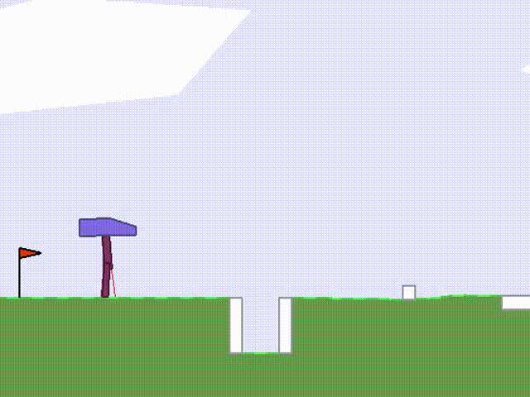
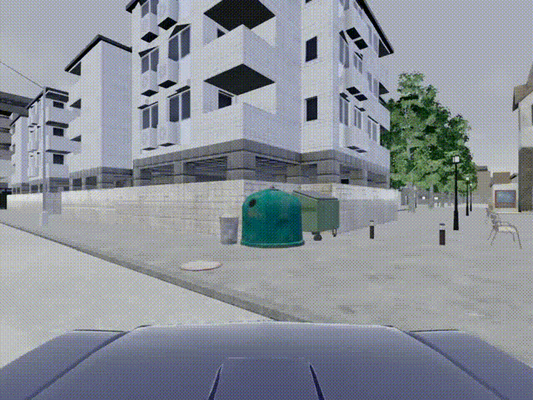
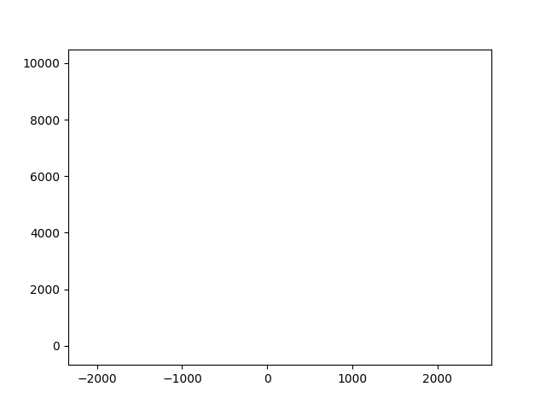
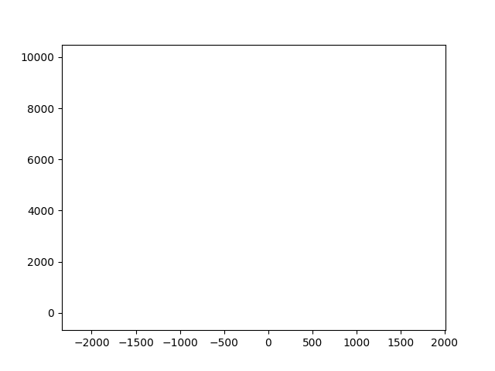
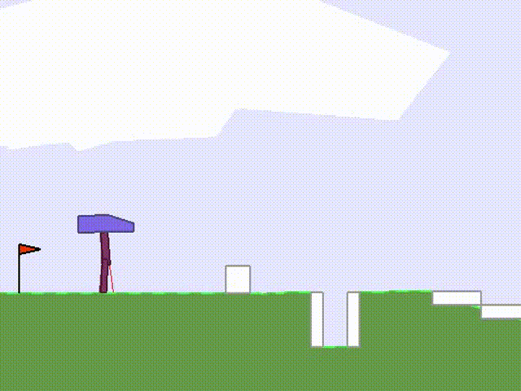
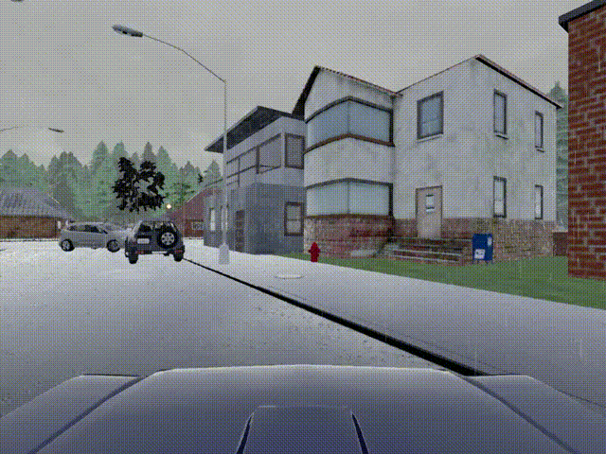
RL for BipedalWalker Game
Crashes of IL for CARLA
Lei HAN(lhanao@connect.ust.hk)
The Hong Kong University of Science and Technology
3 May 2024
8
Notes:
University of Oxford - Oxford Internet Institute
Lehdonvirta, Vili and Shi, Lulu and Hertog, Ekaterina and Nagase, Nobuko and Ohta, Yuji, The Future(s) of Unpaid Work: How Susceptible Do Experts From Different Backgrounds Think the Domestic Sphere Is to Automation (January 5, 2023). Available at SSRN: https://ssrn.com/abstract=4017695 or http://dx.doi.org/10.2139/ssrn.4017695
Collide

Slide 9
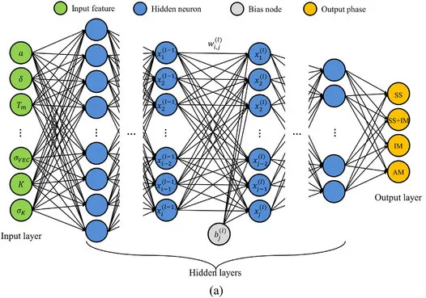
Challenges in testing Decision-Making Policies
DNN-based decision-making policies are hard to test
Most decision-making policies employ DNN models
which are black-box and hard to test.
The infinite state space
is impossible to be exhaustively tested.
Existing testing methods might be ineffective:
some methods (e.g. MDPFuzz) mutate the intermediate states in a trajectory to explore the failures. (break the continuity of trajectory)
some methods (e.g. 𝜋-fuzz) search the cases which violate predefined metamorphic relations. (requires domain knowledge)
Lei HAN(lhanao@connect.ust.hk)
The Hong Kong University of Science and Technology
3 May 2024
9

Slide 10
How to improve testing Decision-Making Policies
We need diversity of the test results, and effectiveness of the method.
Diversify the agent behaviors:
executing similar test cases tends to exercise similar agent behaviors;
diverse test cases could increase the exploration of the fault space;
Develop an effective testing method to adapt more test scenarios:
identifying potential failures efficiently and accurately;
effective test cases detect corner cases and increase the possibility of identifying severe vulnerabilities.
Lei HAN(lhanao@connect.ust.hk)
The Hong Kong University of Science and Technology
3 May 2024
10

Slide 11
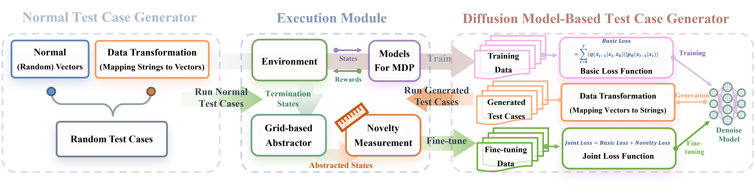
Proposed Method: An Overview
Method: diffusion model + novelty-based guidance
Introduction of novelty-based guidance to measure the freshness of the trajectories.
This method operates in two phases:
(1) train the diffusion model to scale the test case distribution;
(2) fine-tune the diffusion model to generate test cases which induce diverse agent behaviors.
Lei HAN(lhanao@connect.ust.hk)
The Hong Kong University of Science and Technology
3 May 2024
11

Slide 12
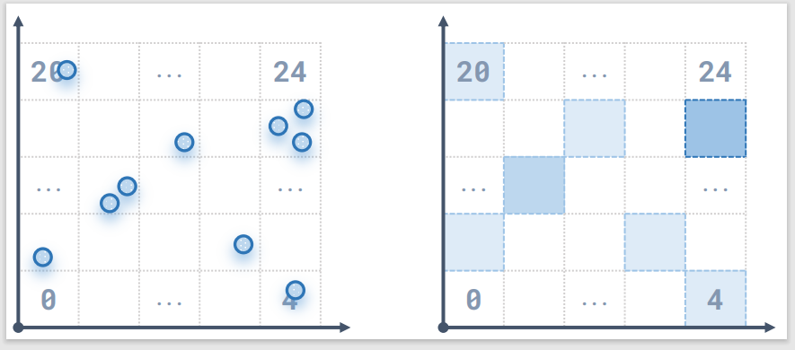
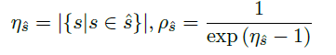
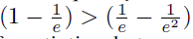
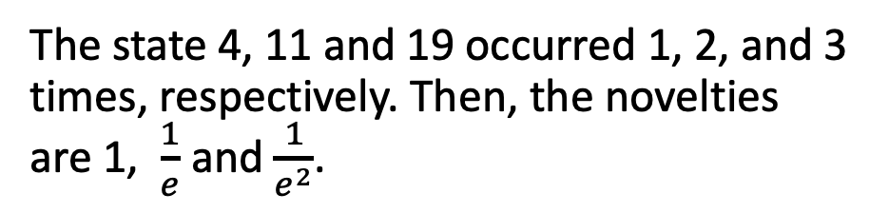
Proposed Method: Novelty-Based Guidance
How to measure the diversity of agent behaviors? ------ Novelty
We abstract the concrete state spaces into equal grids.
Each grid is an abstract state.
The novelty is measured by the visits of abstract states:
Higher visits -> Lower novelty
Lower visits -> Higher novelty
We represent the trajectory (behavior) diversity by the termination state novelty.
19
11
The state 4, 11 and 19 occurred 1, 2, and 3 times, respectively. Then, the novelties are 1, $\frac{1}{e}$ and $\frac{1}{e^{2}}$.
Lei HAN(lhanao@connect.ust.hk)
The Hong Kong University of Science and Technology
3 May 2024
12

Slide 13
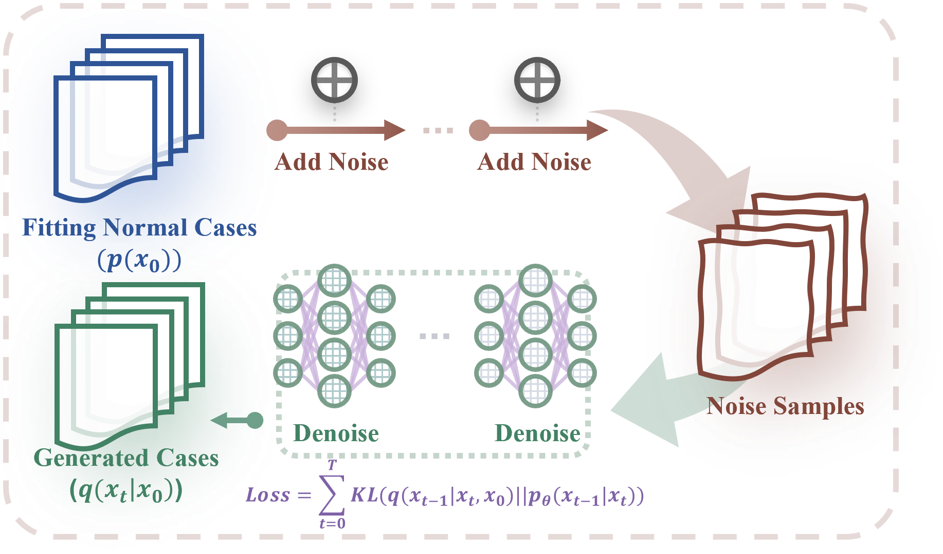
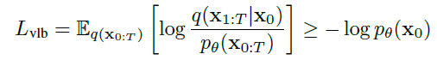
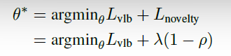
Proposed Method: Diffusion Model-Based Test Case Generator
Diffusion model: Input = random noises, output (generation) = new test cases.
Diffusion models are representative generative models. Diffusion model-based test case generator follows an encoding-decoding workflow:
Add noise to the test cases
Recover the noise sample back to test cases
Diffusion model-based test case generators learn the correspondence and transformation relationships:
Gaussian noisy samples <-> test cases.
We bind the novelty-based metrics with the loss function of diffusion models.
We encourage the diffusion model to fit test cases that induce the termination states with high novelties.
Lei HAN(lhanao@connect.ust.hk)
The Hong Kong University of Science and Technology
3 May 2024
13

Slide 14
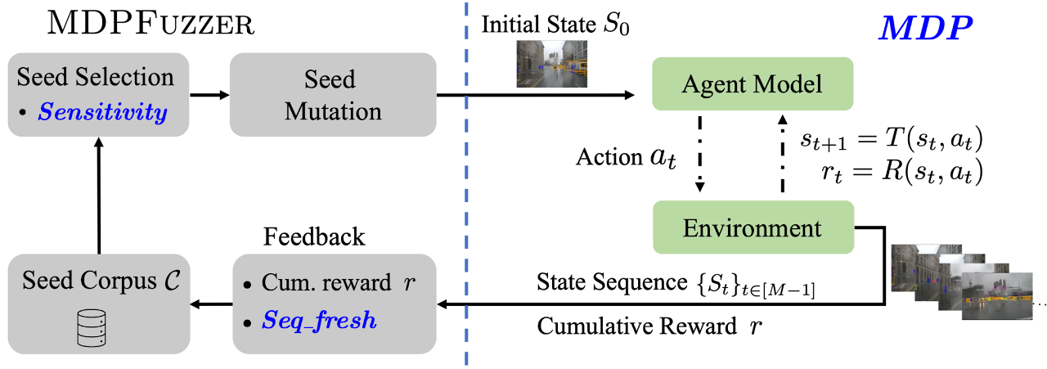
Implementation
Baseline Method: MDPFuzz
Pipeline of MDPFuzz.
Lei HAN(lhanao@connect.ust.hk)
The Hong Kong University of Science and Technology
4 May 2024
14
Notes:
the length of which was determined by their level of complexity
the first blackbox fuzz testing framework
Definition 2 (Crash-triggering state sequences). Given model 𝜋 and a valid and solvable initial state 𝑆0, we observe a state sequence: {𝑆𝑡 }𝑡 ∈ [𝑀−1] , whose actions are made by 𝜋. 𝑆0 is regarded as crash-triggering if there exists a crash state 𝑆𝑡 (𝑡 > 0).
MDP starts from the initial state 𝑆0 and observes the interaction between the target agent model and the environment for 𝑀 timesteps (line 2). It returns the sequence of covered states and the cumulative reward (line 3). The length 𝑀 of the state sequence is a hyper-parameter. •
Sensitivity estimates the sensitivity of the target model against MDPFuzz’s mutations on the initial states (see Sec. 5.1). A larger sensitivity indicates that the model becomes less robust (a good indicator for testing) w.r.t. the mutated initial states. This is comparable to estimating seed energy in software fuzzing [16, 24].
• Seq_fresh estimates the state sequence “freshnessž (see Sec. 5.2). Overall, it checks whether a sequence of covered states has new patterns that do not exist in previously-found sequences. This is comparable to taking code coverage as feedback in software fuzzing [50, 98]. Note that MDPFuzz can observe state sequence in blackbox settings.

Slide 15
Implementation
Environment and Decision-making Policies
(1) BipedalWalker game in the Gym domain, (2) Cooperative Navigation (Coop Navi) task, (3) ACAS-Xu collision avoidance task, and (4 & 5) two CARLA autonomous driving tasks
Experimental Settings and Hyperparameters
During a 12-hour testing period, experiments were conducted on CARLA and BipedalWalker, while the other tasks underwent testing for one hour each, the length of which was determined by their level of complexity. In order to maintain consistency and impartiality, the hyperparameters utilized were sourced from the official open-access version of MDPFuzz.
Implementation and Hardware
Software for implementation and model training of diffusion model: Python 3.7.4 + Numpy1.19.5 + PyTorch 1.13.
Hardware: 14-core Intel i9-10940X CPU + Nvidia A6000 GPU + 128GB of RAM + Ubuntu 20.04.
Lei HAN(lhanao@connect.ust.hk)
The Hong Kong University of Science and Technology
4 May 2024
15
Notes:
the length of which was determined by their level of complexity

Slide 16
Experiment: Research Questions
RQ1: Numbers of detected failures
RQ2: Novelty vs other guidance (density, sensitivity, reward, etc.)?
RQ3: Diversity of detected failures
RQ4: Repairing based on the detected failures
Lei HAN(lhanao@connect.ust.hk)
The Hong Kong University of Science and Technology
3 May 2024
16

Slide 17
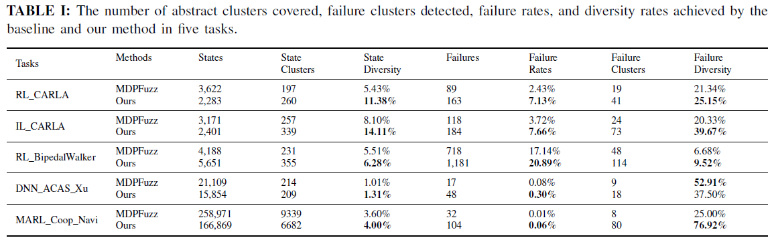
RQ1: Numbers of detected failures
RQ3: Diversity of detected failures
The proposed method is more efficient in detecting failures than the baseline method.
The proposed method surpasses the baseline method in covering a broader range of states and failures within the given number of test cases.
Lei HAN(lhanao@connect.ust.hk)
The Hong Kong University of Science and Technology
3 May 2024
17
Notes:
$$s :state | s_{∗} :state with failures |\hat{ s} :abstract state | {\hat{s}}_{∗} :abstract state with failures.$$

Slide 18
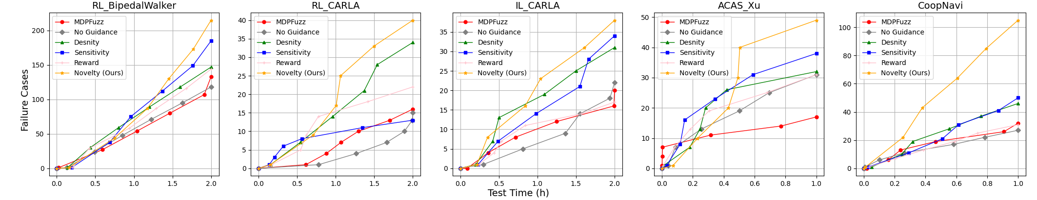
RQ2: Novelty vs other guidance (density, sensitivity, reward, etc.)?
The proposed method with novelty-based guidance detects the most failures.
The proposed method achieves the highest number of detected failures.
Novelty is the best guidance for improving the test efficiency.
Lei HAN(lhanao@connect.ust.hk)
The Hong Kong University of Science and Technology
3 May 2024
18

Slide 19
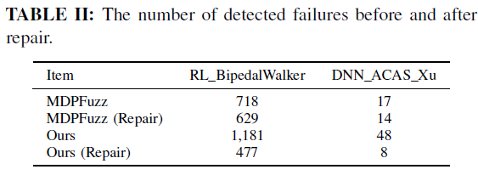
Experiment: RQ4 Robustness improvement by the detected failures
The robustness improvement proves the high quality of our detected failures.
The failure cases detected by our method can help improve the robustness of decision-making policies.
Additionally, repairing evaluated models using our detected failure cases leads to a more significant improvement in robustness compared to the baseline method.
Lei HAN(lhanao@connect.ust.hk)
The Hong Kong University of Science and Technology
3 May 2024
19

Slide 20
Why is this paper selected?
AI/ML is very popular as well as their testing
Software testing theory and practice relating to the intelligent agent can benefit human beings and the industry.
Employment of generative diffusion model
A generative diffusion model is employed to adapt to various search spaces, capture test case distributions, and generate test cases efficiently. Additionally, a novel novelty-based guidance approach is proposed to assess trajectory freshness and diversify agent behaviors. This approach is integrated with the diffusion model to enable effective testing of decision-making policies.
Novelty
Relative few similar research
Lei HAN(lhanao@connect.ust.hk)
The Hong Kong University of Science and Technology
3 May 2024
20

Slide 21
Thank you for your attention!
Lei HAN(lhanao@connect.ust.hk)
The Hong Kong University of Science and Technology
3 May 2024
21

